Slide 1
Pointers in C++

Slide 2
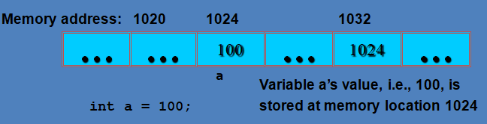
BASIC OVERVIEW
Each variable is assigned a memory slot (the size depends on the data type) and the variable’s data is stored there.

Slide 3
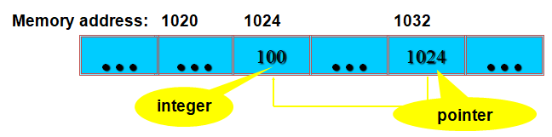
POINTERS
A pointer is a variable used to store the address of a memory cell.
We can use the pointer to reference this memory cell
It is a derived data type; that is it is built from one of the standard types. Its value may be any of the addresses available in the computer for storing and accessing the data

Slide 4
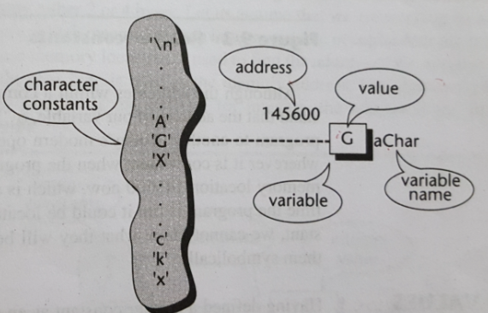
CHARACTER CONSTANT AND VARIABLES

Slide 5
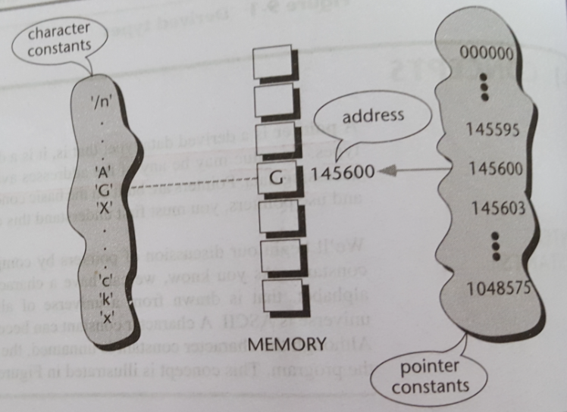
POINTER CONSTANTS

Slide 6
Eg :- to print character addresses
#include <iostream.h>
int main ()
{
char a , b;
cout<<&a<<&b;
return 0;
}

Slide 7
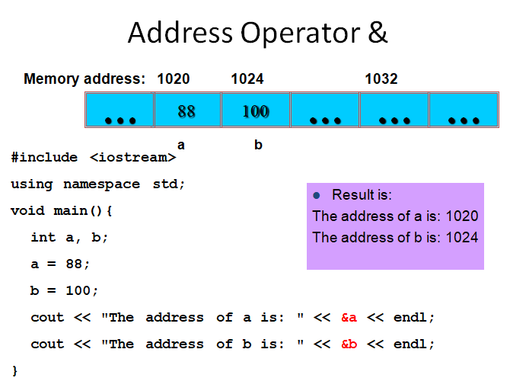

Slide 8
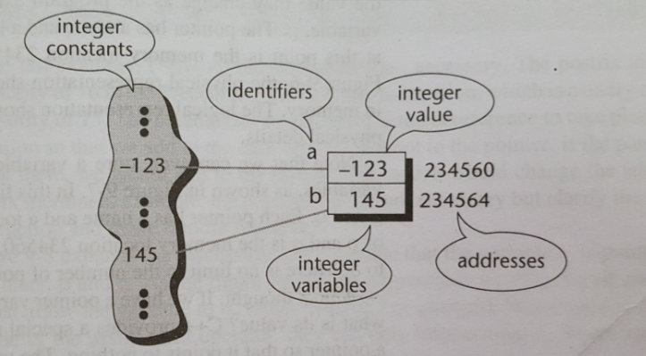
Integer constants and variables

Slide 9
POINTER VARIABLES
(REPRESENTATIONS)

Slide 10
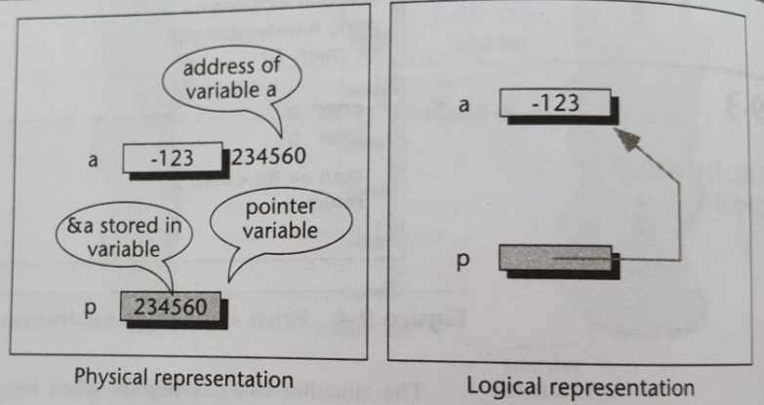
PHYSICAL VS LOGICAL REPRESENTATION

Slide 11
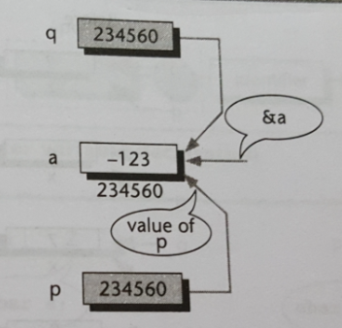
MULTIPLE POINTERS TO A VARIABLE

Slide 12
ACCESSING VARIABLES THROUGH POINTERS

Slide 13
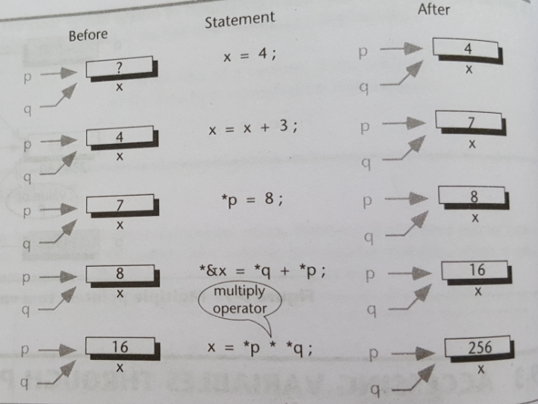

Slide 14
POINTER DECLARATION AND DEFINITION

Slide 15
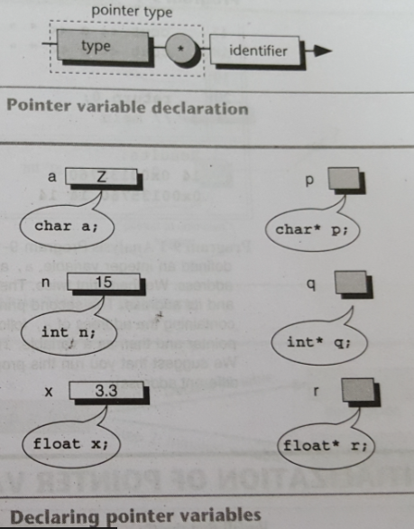
P is the pointer to a character
Q is a pointer to integer
R is a pointer to a floating point variable

Slide 16
EG:- USE OF POINTERS
int main()
{
int a , *p;
a=14 , p=&a;
cout <<a<<“ “<<&a<<“\n”;
cout<<p<<“ “<<*p<<“ “ <<a<<“\n”;
return 0;
}
Output
14 Ox00135760
Ox00135760 14 14

Slide 17
INITIALIZATION OF POINTER VARIABLES

Slide 18
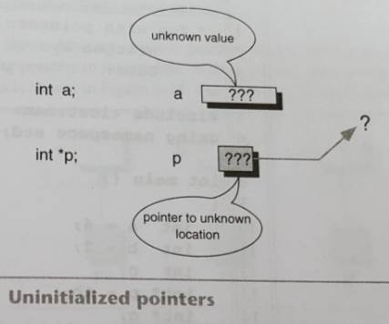
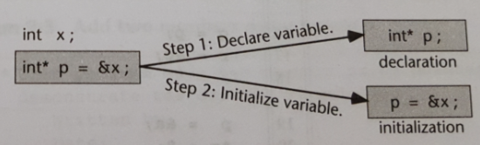

Slide 19
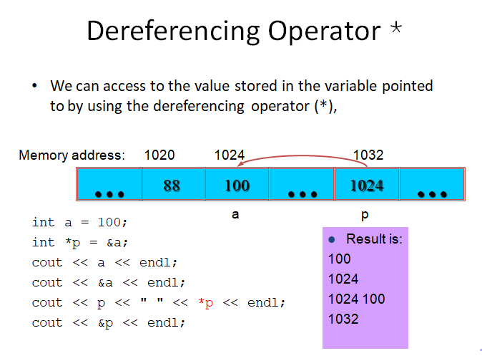

Slide 20
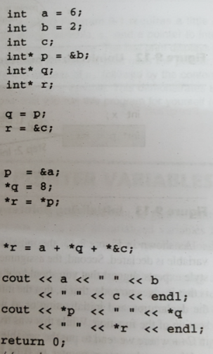
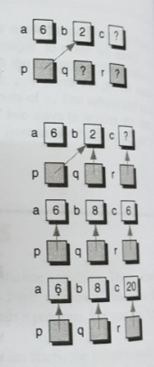
FUN WITH POINTERS
8 20
6 8 20

Slide 21
ADD TWO NUMBERS USING POINTERS
int main ()
{int a , b , r ;
int* pa =&a;
int* pb =&b;
int* pr =&r;
cin>>*pa>>*pb;
*pr=*pa+*pb;
cout<<*pr
return 0;}

Slide 22
POINTER FLEXIBILITY (using one pointer for many variables)
int a , b , c;
int * p;
cin >>a>>b>>c;
p=&a;
cout<<*p;
p=&b;
cout<<*p;
p=&c;
cout<<*p;

Slide 23
MULTIPLE POINTERS FOR ONE VARIABLE
int a;
int* p=&a;
int* q=&a;
int* r=&a;
cin>>a;
cout<<*p<<“\n”;
cout<<*q<<“\n”;
cout<<*r<<“\n”;

Slide 24
POINTERS AND FUNCTIONS

Slide 25
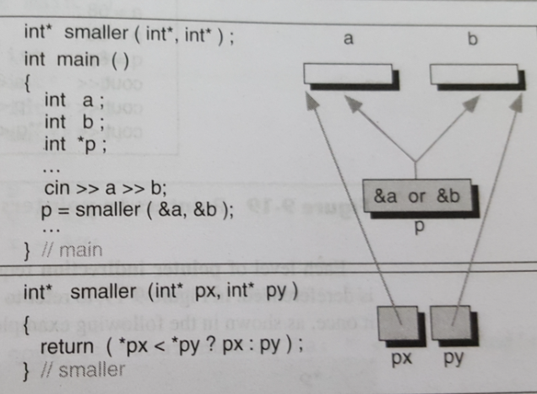
FUNCTIONS RETURNING POINTERS

Slide 26
POINTERS TO POINTERS

Slide 27
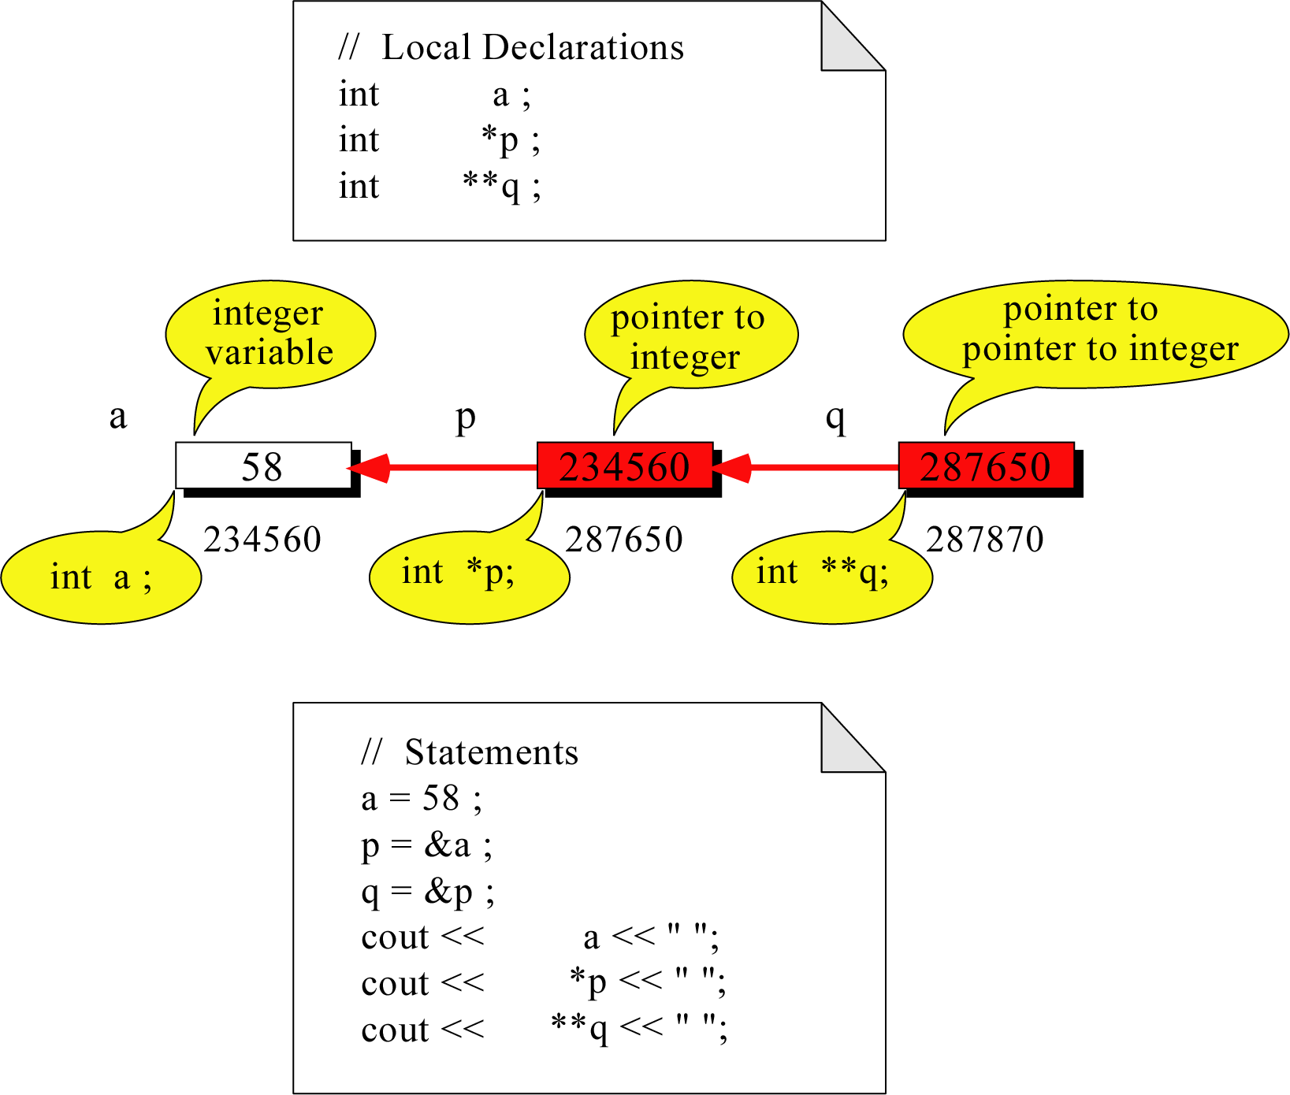
What is the output?
58 58 58

